Slide 1
Introduction to Python Classes

Slide 2

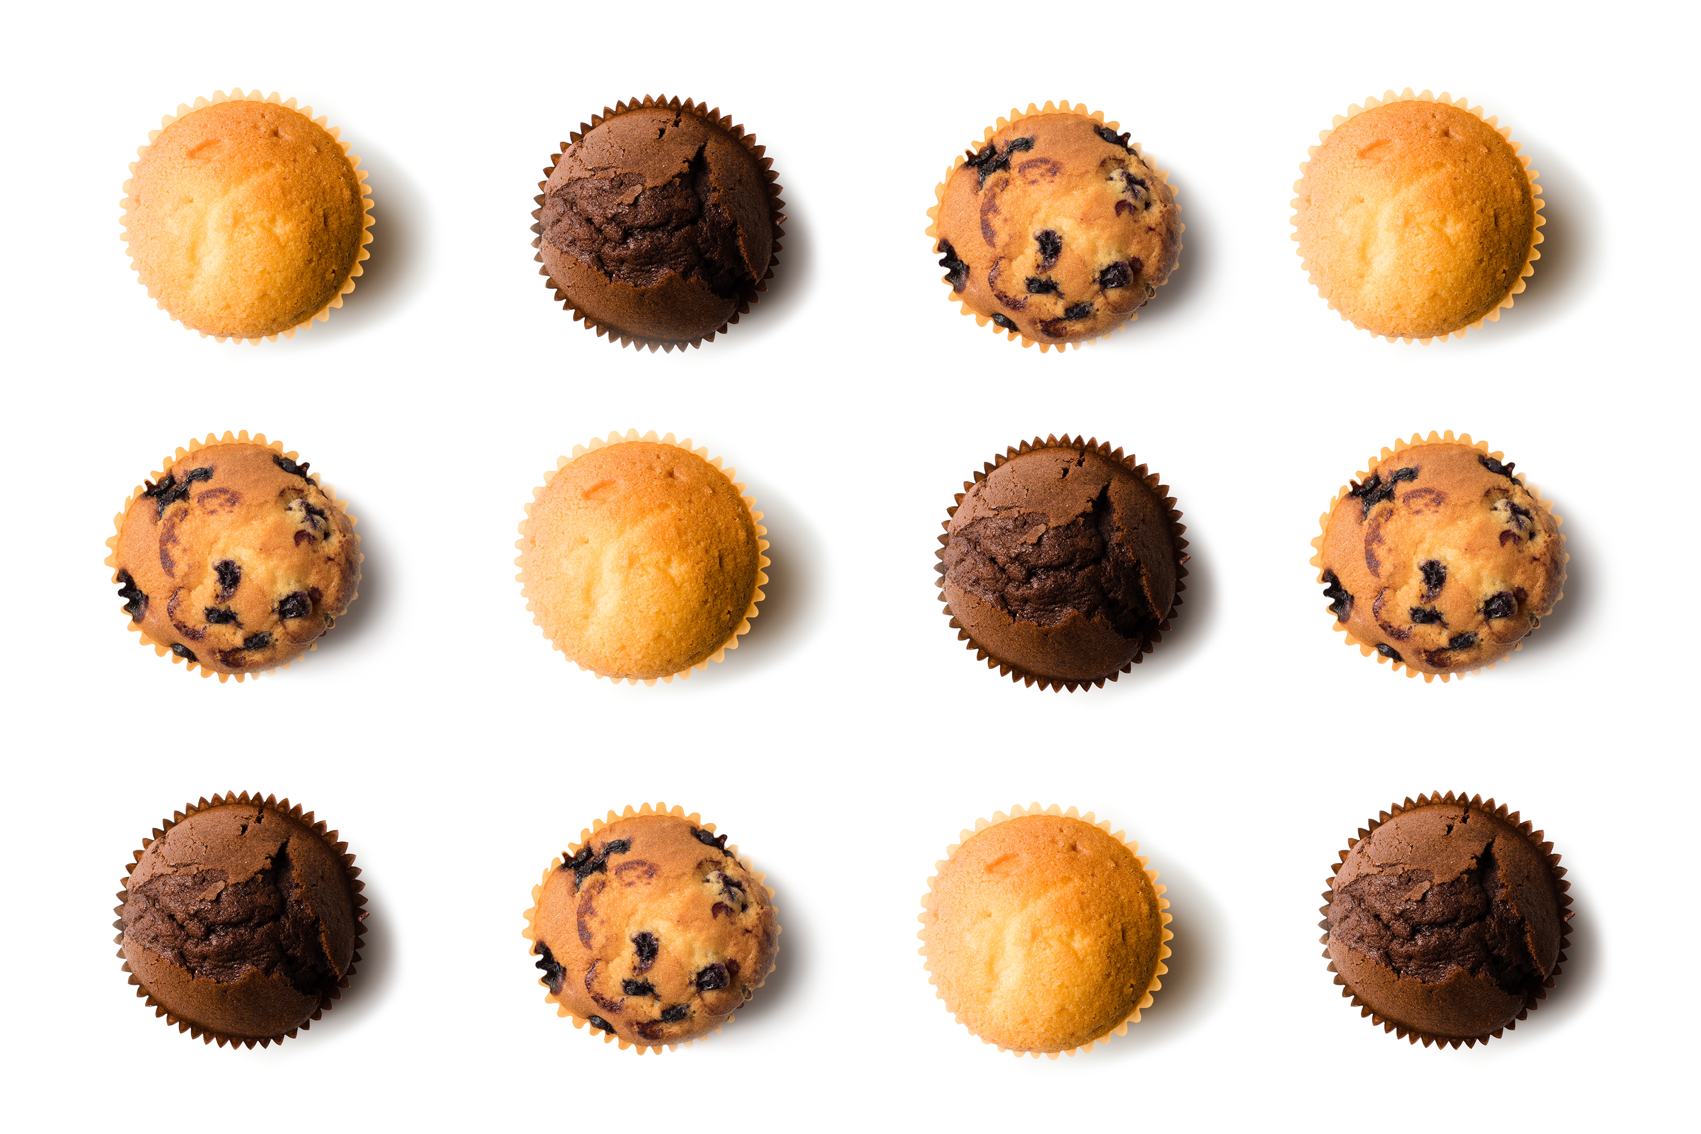
What Are Classes and Objects?
- A class is like a blueprint or recipe for creating things.
- Class: A cookie recipe
- Example:
- An object is the actual thing made from the class.
- Object: A chocolate chip cookie.

Slide 3
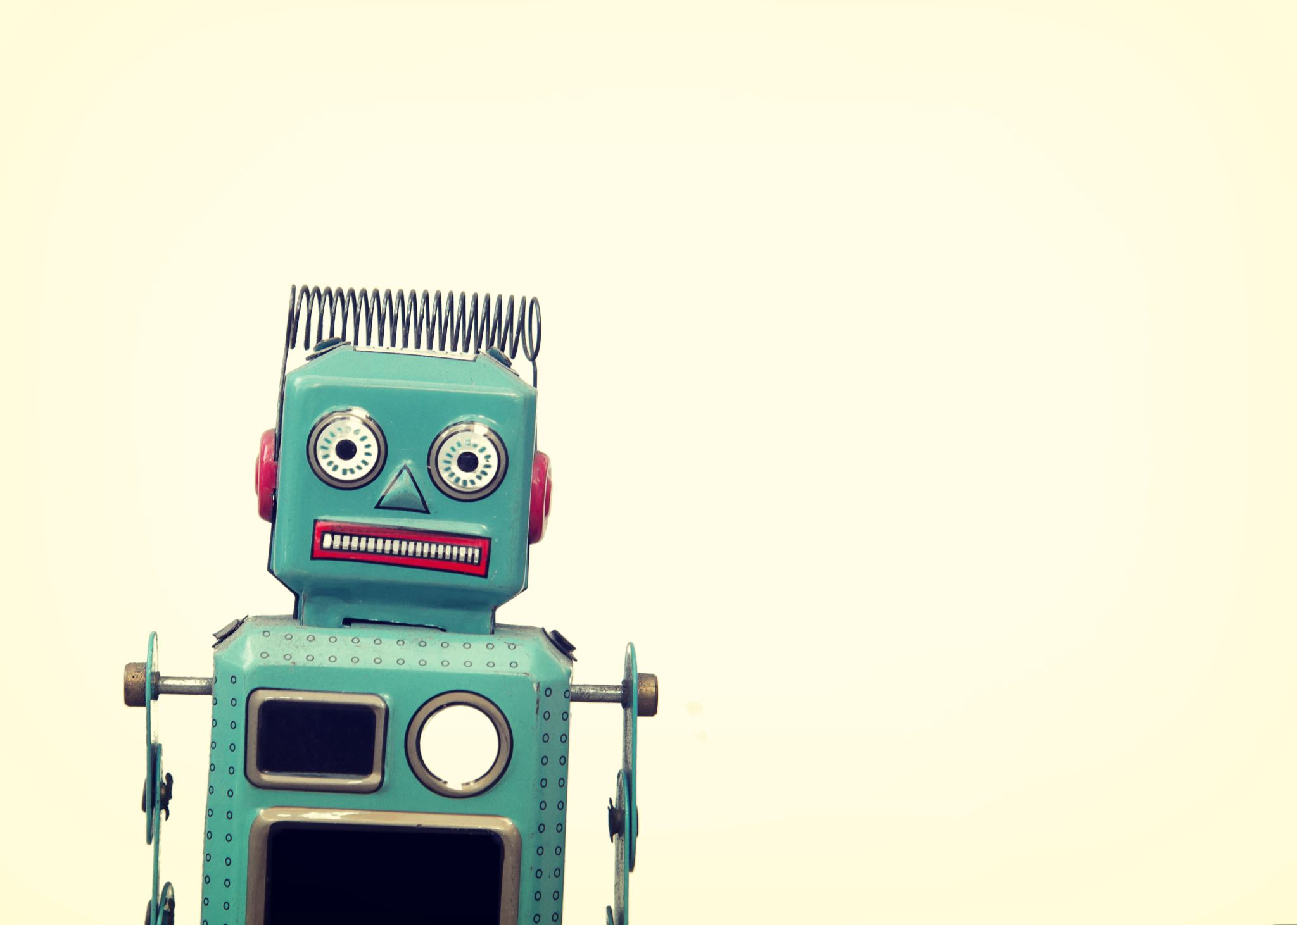
Why Use Classes?
- Classes help us organize and reuse code.
- Instead of writing the same code for every object, use a class to make many objects.
- Example:
- Write one class for a robot, then use it to create 10 different robots.

Slide 4
Key Words for Beginners
- *Class*: A template or blueprint (e.g., Robot).
- *Object*: A real thing made from the class (e.g., robot1).
- *__init__*: A special method to set up the object.
- *self*: Helps the Class know about itself.
- *Attributes*: Things the object has (e.g., name, colour).
- *Methods*: Things the object can do (e.g., say_hello).

Slide 5

Python Class Example
class Robot:
def __init__(self, name, colour):
self.name = name
self.Colour = colour
- This creates a class called 'Robot’.
- '__init__' sets up the object.
- 'self.name' and 'self.colour' are attributes.

Slide 6
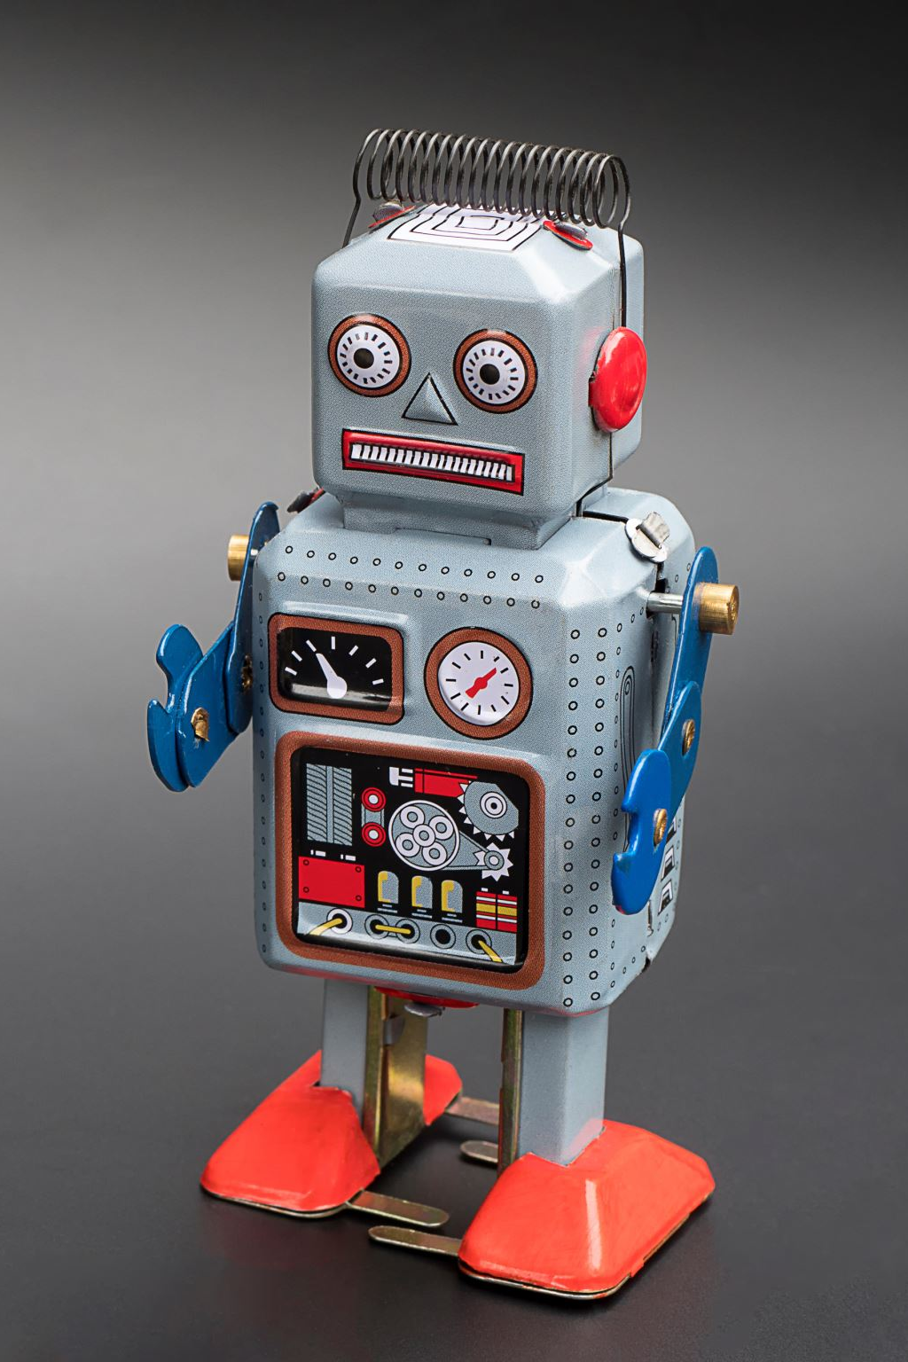
Creating an Object
robot1 = Robot('Robo1', 'Red')
robot2 = Robot('Robo2', 'Blue')
- 'robot1' is a red robot named Robo1.
- 'robot2' is a blue robot named Robo2.

Slide 7
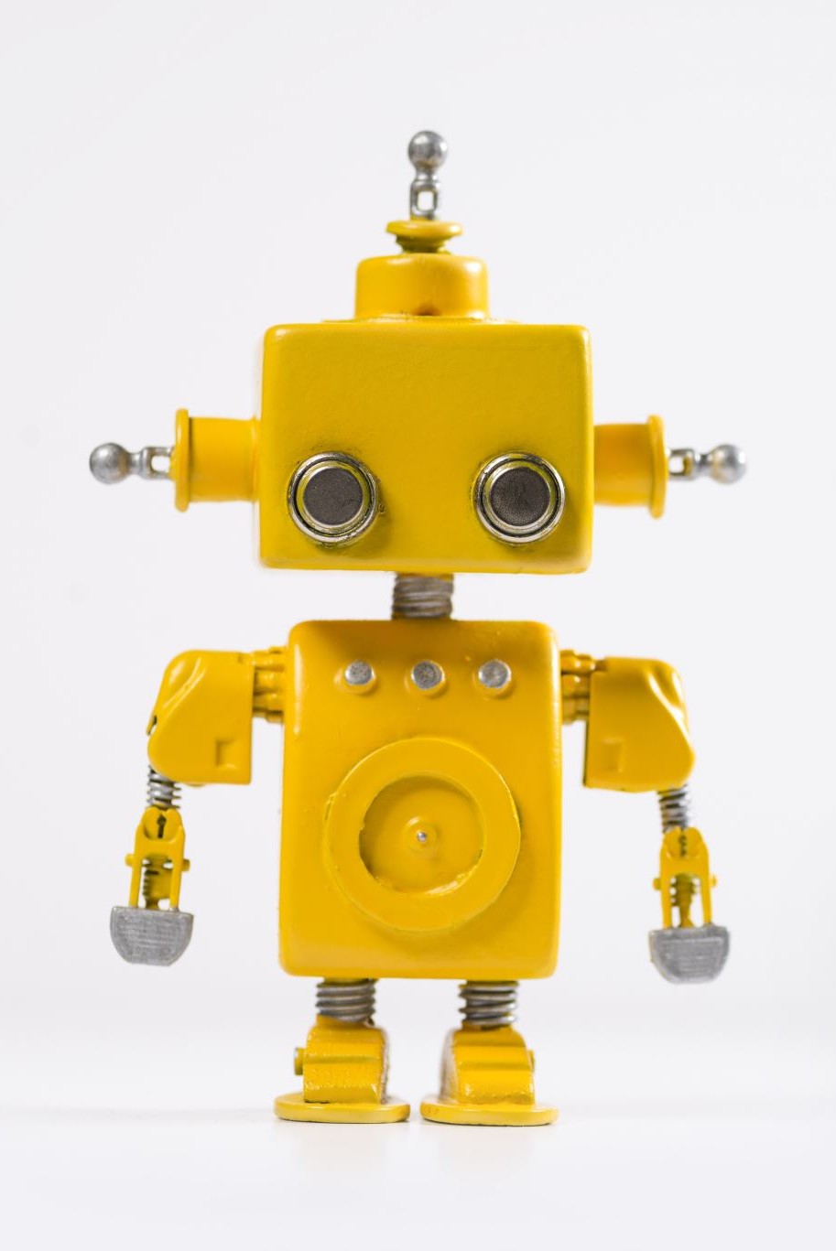
Adding Actions to the Robot
class Robot:
def __init__(self, name, colour):
self.name = name
self.colour = colour
def say_hello(self):
print(f'Hello! My name is {self.name} and I am {self.colour}.')
- 'say_hello' is a method for the robot to introduce itself.

Slide 8
Using the Robot
robot1.say_hello() # Hello! My name is Robo1 and I am Red.
robot2.say_hello() # Hello! My name is Robo2 and I am Blue.
- The robot uses its attributes (name and colour) to say hello.

Slide 9
What We Learned
- Class: The blueprint/template.
- Object: The real thing made from the class.
- Attributes: What the object has.
- Methods: What the object can do.
- Example:
- Class: Robot
- Object: Robo1
- Attributes: Name = 'Robo1', Colour = 'Red'
- Method: say_hello

Slide 10
Real-World Examples of Classes
- Class: Animal
- Attributes: Species, Colour, Size
- Methods: Eat, Sleep, MakeSound
Class: Car
- Attributes: ?????
- Methods: ?????
Class: Phone
Attributes: ????
- Methods: ????

Slide 11
Quick Quiz!
1. What is a class?
2. What is an object?
3. What does '__init__' do?
4. What is 'self' used for?
5. Write code to create a robot named 'Robo3' that is green.

Slide 12
Design Your Own Class
1. Pick a theme (e.g., superheroes, cars, pets).
2. Create a class for it.
3. Add at least:
- 2 attributes (e.g., name, ability).
- 1 method (e.g., introduce).
4. Create an object and use your method.

Slide 13
Worksheet Practice

